Slide 1
North South University
Department of History & Philosophy
HIS 103: Emergence of Bangladesh
2nd Session: Battle of Palashi 1757, British East India Company and its trade interests
Faculty : Shakil Ahmed, PhD (SA2) Assistant Professor
E-mail : shakil.ahmed@juniv.edu
Twitter : @Shakil553
Office : NAC 1054

Slide 2
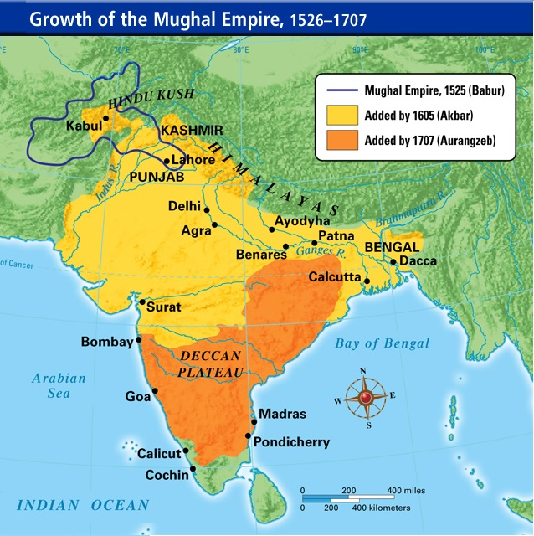
Mughal Empire

Slide 3
Dhaka in 1700s
Dhaka in the 1700s was a city with a population of over a million, one of the wealthiest cities in the world, with an estimated 80,000 skilled textile weavers. Dhaka was an exporter of silk and cotton textiles, steel, saltpeter, agricultural and industrial produce.*
*Khandker, Hissam (31 July 2015). “Which India is claiming to have been colonised?”. The Daily Star (Op-ed).

Slide 4
The wealth of Bengal
Bengal was the Mughal Empire’s wealthiest province*. It generated 50% of the empire's GDP and 12% of the world's GDP.**
*M. Shahid Alam (2016). Poverty From The Wealth of Nations: Integration and Polarization in the Global Economy since 1760. Springer Science+Business Media. p. 32.
**Khandker, Hissam (31 July 2015). “Which India is claiming to have been colonised?”. The Daily Star (Op-ed).

Slide 5
Mughal empire and Bengal
Relative independence of Bengal under Mughal empire.
- Bengal Sultanate (Before Mughal 14th century)
- Bengal Subah (16th and 18th centuries)
- Nawab (18th century)

Slide 6
East India Company
East India Company 16th–19th-century English and British trading company.
Later it became British joint-stock company
It blended business and politics together.
It colonized large parts of the Indian subcontinent, colonized parts of Southeast Asia, and colonized Hong Kong after a war with Qing China.

Slide 7
Local elite and East India Company
Local bankers of Bengal and British made unholy allience.
Weak political control help to make alliance between local elite and foreigner.

Slide 8
Siraj ud-Daulah
When Siraj ud-Daulah came in ower. He was only 21 years.
When he was killed he only 22 years

Slide 9
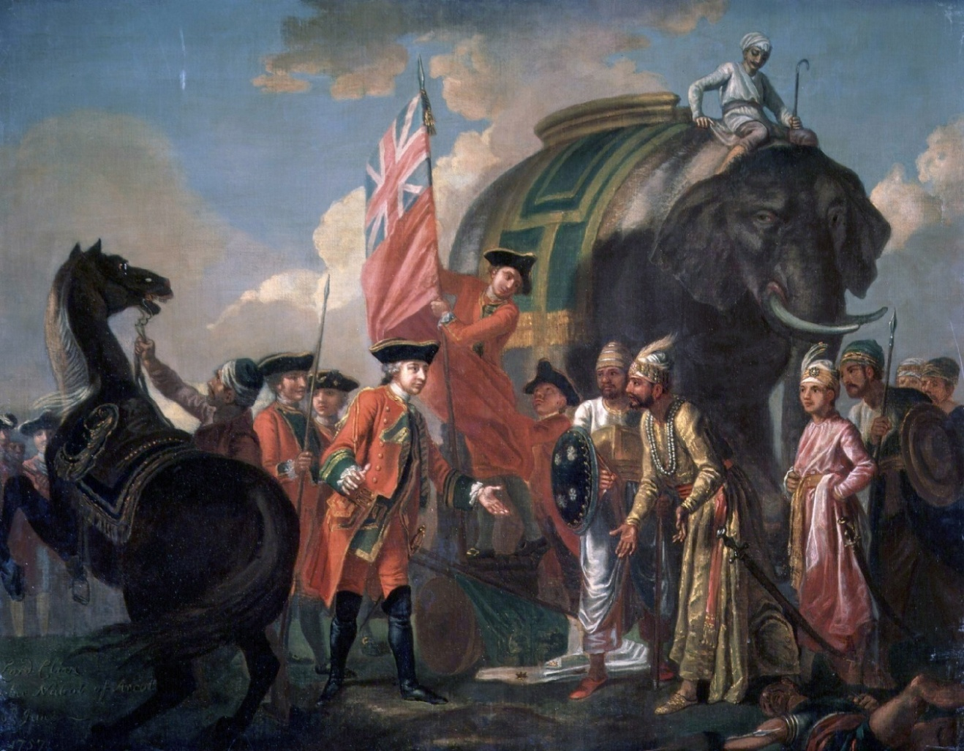
Lord Clive meeting with Mir Jafar
Lord Clive meeting with Mir Jafar at the Battle of Plassey in 1757 by Francis Hayman (1708 ~ 1776)

Slide 10


